Slide 1
Unemployment Rate Forecasting
Team 3
Yang Liu
Hao Ren
Yue Sun
Linghao Yang

Slide 2
Agenda
Business Problem
Data Profile
Data Cleaning
Modeling
Evaluation
Conclusion
Future Work
Reference

Slide 3
Business Problem
Unemployment Rate: The number of unemployed divided by the number in the civilian labor force.
Indicator of the health of the economy
Approaches:
Okun’s law, it is based on the relationship between output growth and unemployment changes.
The second is based on the historical time-series properties of the unemployment rate and indicators of the labor market.

Slide 4
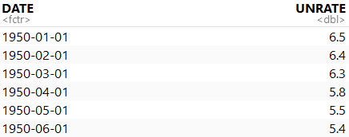
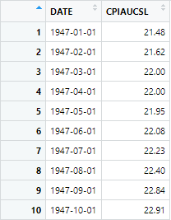
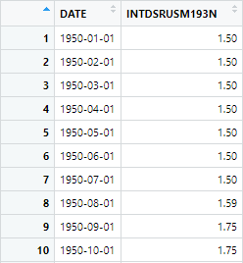
Data Profile
Data: Monthly Unemployment Rate data
855 observations (from 1950-01-01 to 2021-03-01)
2 features (Date and Unemployment Rate)
2 covariates CPI and Interest Rate

Slide 5
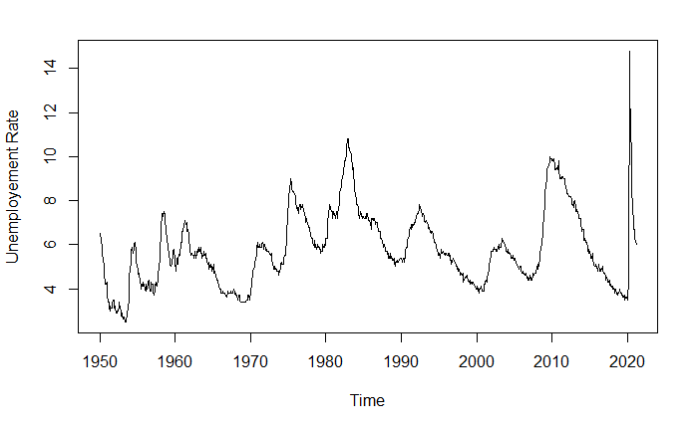

Slide 6
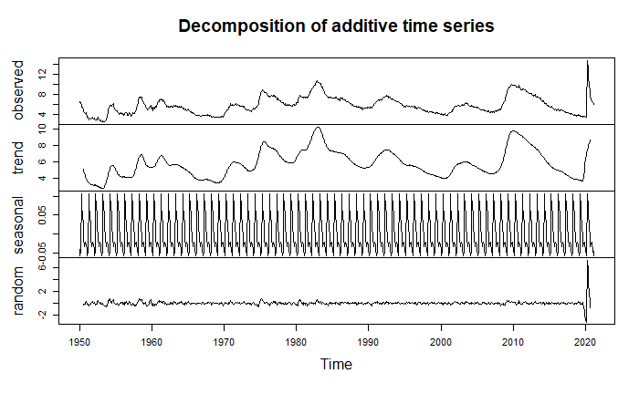

Slide 7
Data Cleaning
1. Splitting the data into training and test dataset
Training dataset: from 1950-01-01 to 2014-12-01
1st Test dataset (Before Covid): from 2015-01-01 to 2019-12-01
2nd Test dataset(With Covid): from 2015-01-01 to 2021-03-01

Slide 8
Data Cleaning
2. Apply Box-Cox transformation with the best lambda value: 0.6446021 on training data.
3. Apply 1st-order difference

Slide 9
Data Cleaning
4. Test for stationary
KPSS test
P-value = 0.1 > 0.05
Accept null hypothesis
The process is stationary

Slide 10
Modeling
Arima / Seasonal Arima
Seasonal Holt Winters
ARFIMA
ETS
VAR

Slide 11
Model 1 - Arima / Seasonal Arima
Arima
ARIMA (2, 1, 2)
AICc = -1390.53
BIC = -1367.32
Seasonal Arima
ARIMA (1, 1, 4) (2, 0, 1) [12]
AICc = -1455.25
BIC = -1413.56

Slide 12
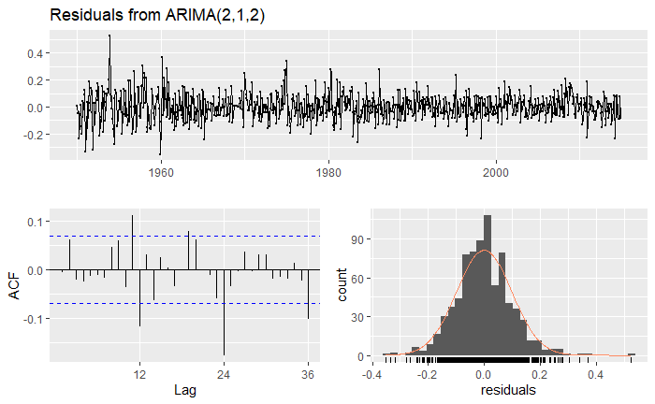
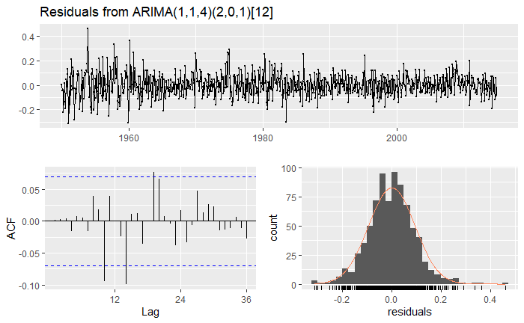
Model 1 - Arima / Seasonal Arima
Arima
Ljung-Box test: p-value = 5.819e-08 < 0.05
Seasonal Arima
Ljung-Box test: p-value = 0.02205 < 0.05

Slide 13
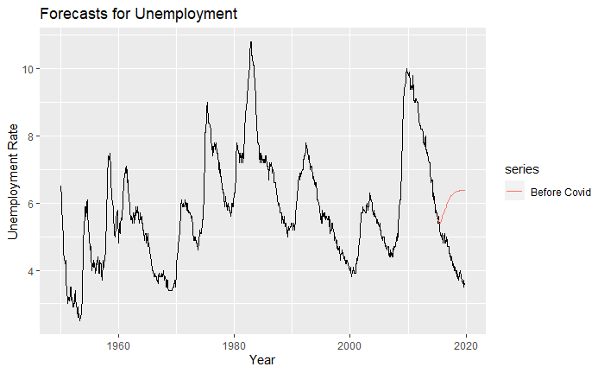
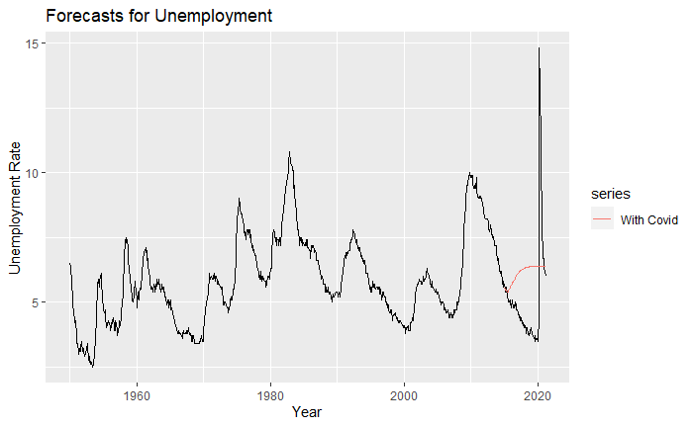
Model 1 - Seasonal Arima
1st test dataset: 2015-01-01 - 2019-12-01
2nd test dataset: 2015-01-01 - 2021-03-01

Slide 14
Model 2 - Seasonal Holt Winters
Seasonal = additive, damped = TRUE
Seasonal = additive, damped = FALSE
Seasonal = multiplicative, damped = TRUE
Seasonal = multiplicative, damped = FALSE

Slide 15
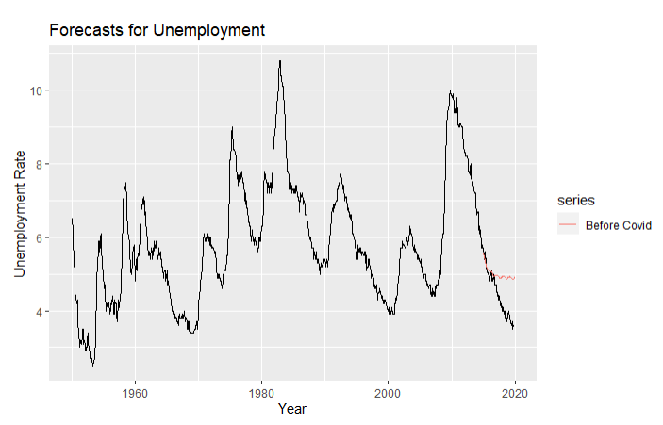
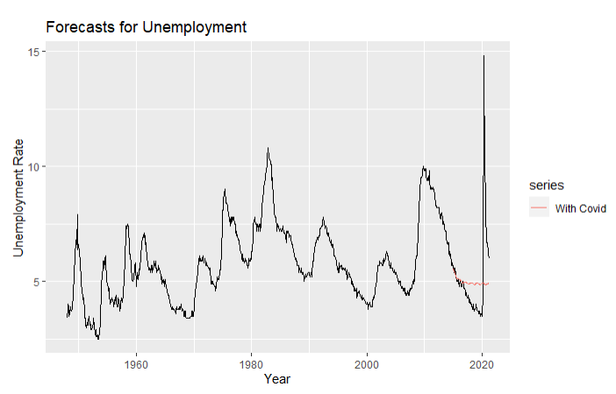
Model 2 - Seasonal Holt Winters

Slide 16
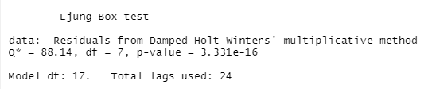
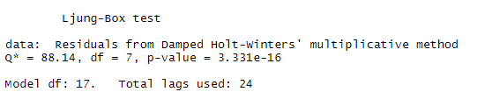
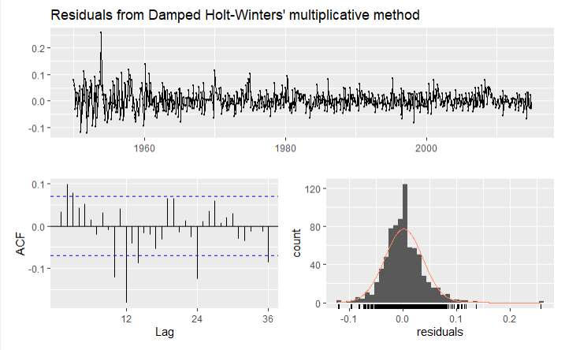
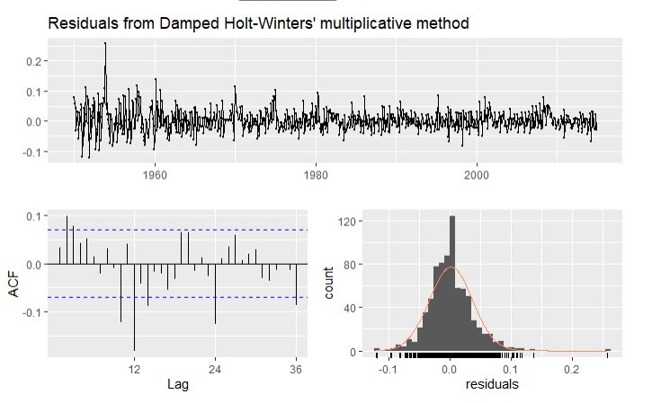
Model 2 - Seasonal Holt Winters

Slide 17
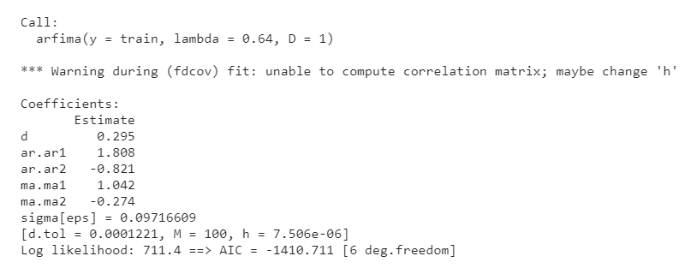
Model 3 - ARFIMA
ARFIMA
ARFIMA(2, 0.3, 2)
AIC = -1410.711

Slide 18
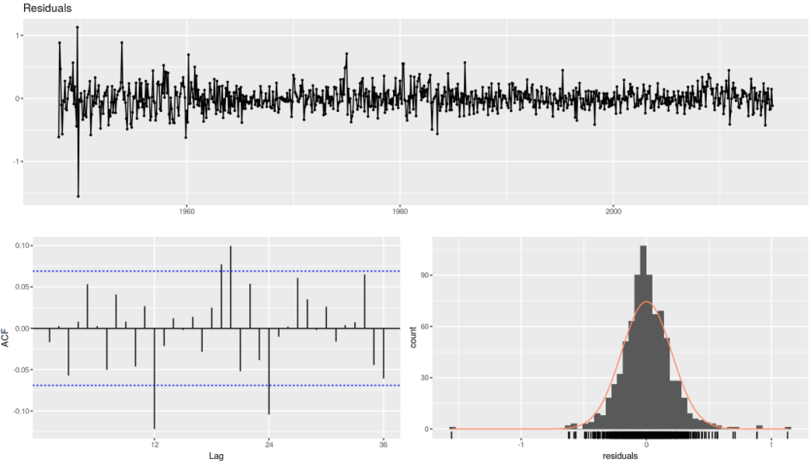
Model 3 - ARFIMA
ARFIMA
Ljung-Box test: p-value = 0.0003182

Slide 19
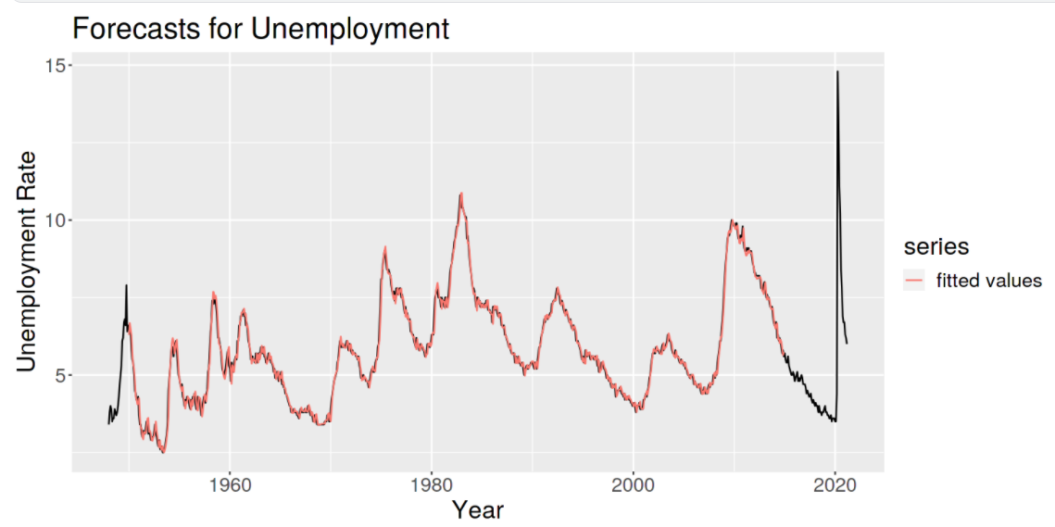
Model 3 - ARFIMA

Slide 20
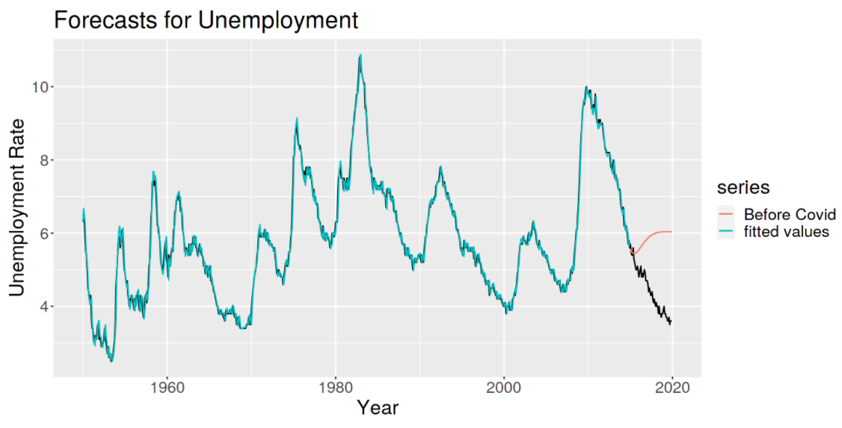
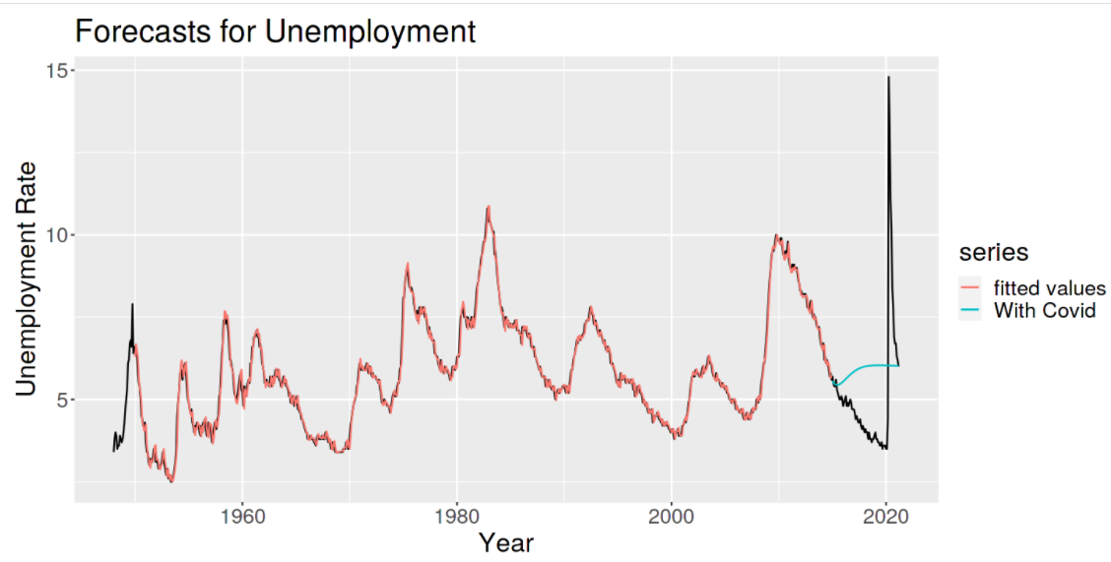
Model 3 - ARFIMA
1st test dataset: 2015-01-01 - 2019-12-01
2nd test dataset: 2015-01-01 - 2021-03-01

Slide 21
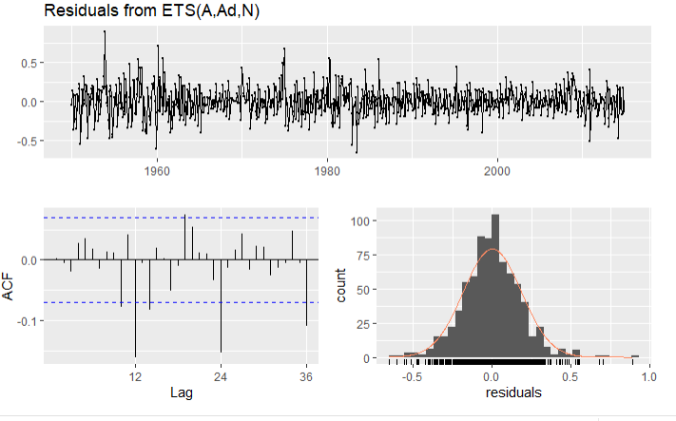
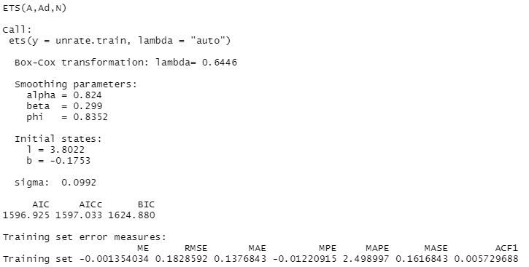
Model 4 - ETS

Slide 22
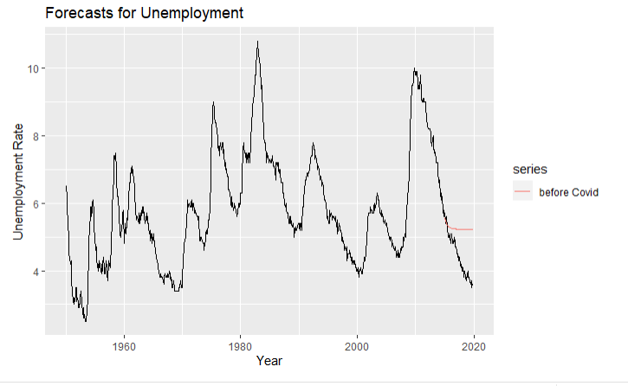
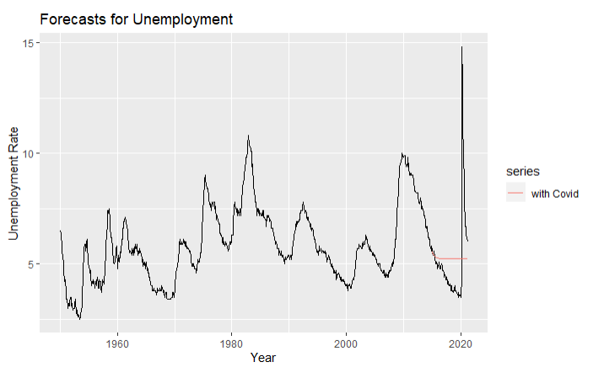
Model 4 - ETS

Slide 23
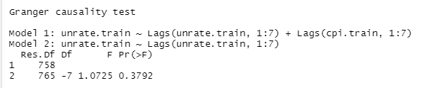

Model 5 - Var model- With CPI & Interest Rate
Prepare CPI and Interest Rate in TS form
Build a model with two covariates together but can’t pass serial.test
Build 2 model by separating the CPI and IR
CPI do not pass granger test (P-value >0.05), and also can not pass serial.test (Not good p)
Use serial test to find a appropriate order of lag for model after the VARselect

Slide 24
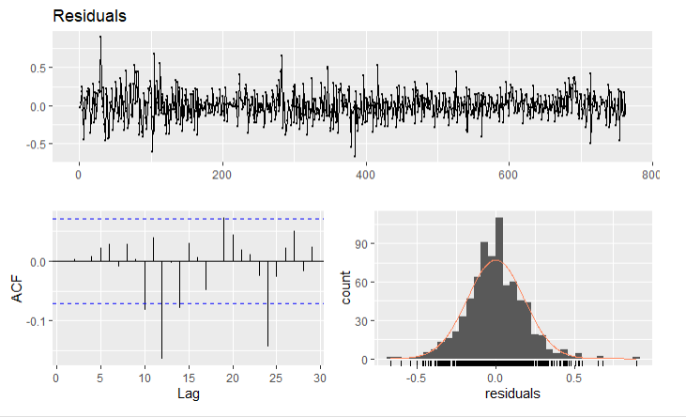
Model 5 - Var model- With Interest Rate
p=6, K=2

Slide 25
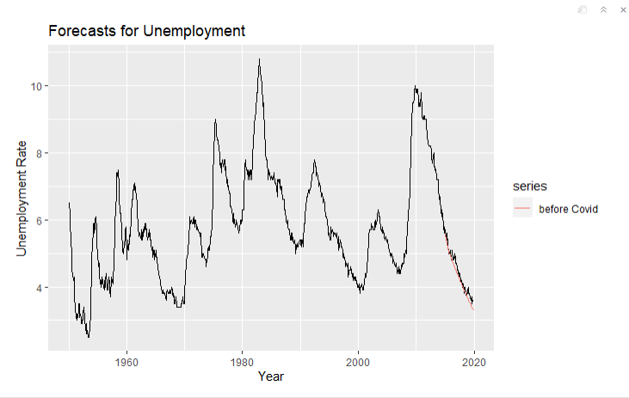
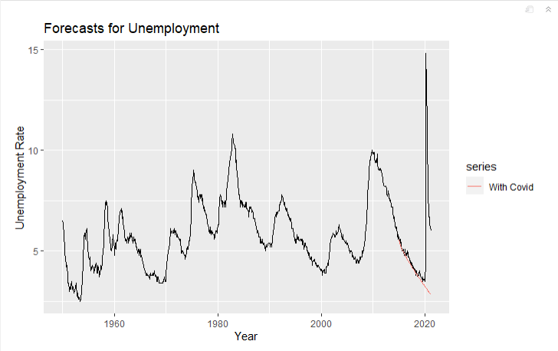
Model 5 - Var model- With Interest Rate

Slide 26
Evaluation
1st test dataset: from 2015-01-01 to 2019-12-01
 | Seasonal Arima | Seasonal Holt Winters | ETS | VAR- With Interest Rate | ARFIMA
RMSE | 1.892 | 1.936 | 1.022 | 0.1820 | 1.639
MAE | 1.647 | 1.637 | 0.8608 | 0.1469 | 1.426
MAPE | 40.92 | 40.92 | 21.61 | 3.407 | 35.44

Slide 27
Evaluation
2nd test dataset: from 2015-01-01 to 2021-03-01
 | Seasonal Arima | Seasonal Holt Winters | ETS | VAR- With Interest Rate | ARFIMA
RMSE | 2.305 | 2.356 | 2.038 | 2.544 | 2.191
MAE | 1.810 | 1.394 | 1.301 | 1.053 | 1.660
MAPE | 38.98 | 26.76 | 24.34 | 13.32 | 34.77

Slide 28
Conclusion
VAR model has the best performance compared to other models.
Under the influence of two variables, we did not get more accurate prediction results, maybe CPI is not very good leading indicator
Interest Rate is good lagging indicator for unemployment rate
It is hard to forecast when something unexpected happens.
Notes:
Extreme condition

Slide 29
Future Work
Add more variables into existing models, for example, GDP index
Improve the models by hyperparameter tuning.
Review literature/report/research about unemployment rate to have more insights.

Slide 30
Reference
“Unemployment Rate.” FRED, 7 May 2021, fred.stlouisfed.org/series/UNRATE#0.
Hyndman, R. J., & Athanasopoulos, G. (2018). Forecasting: principles and practice. O Texts.

Slide 31
Thank you!

